Slide 1

R packages for Earth Science
Jonathan Lees
Download from CRAN Website

Slide 2
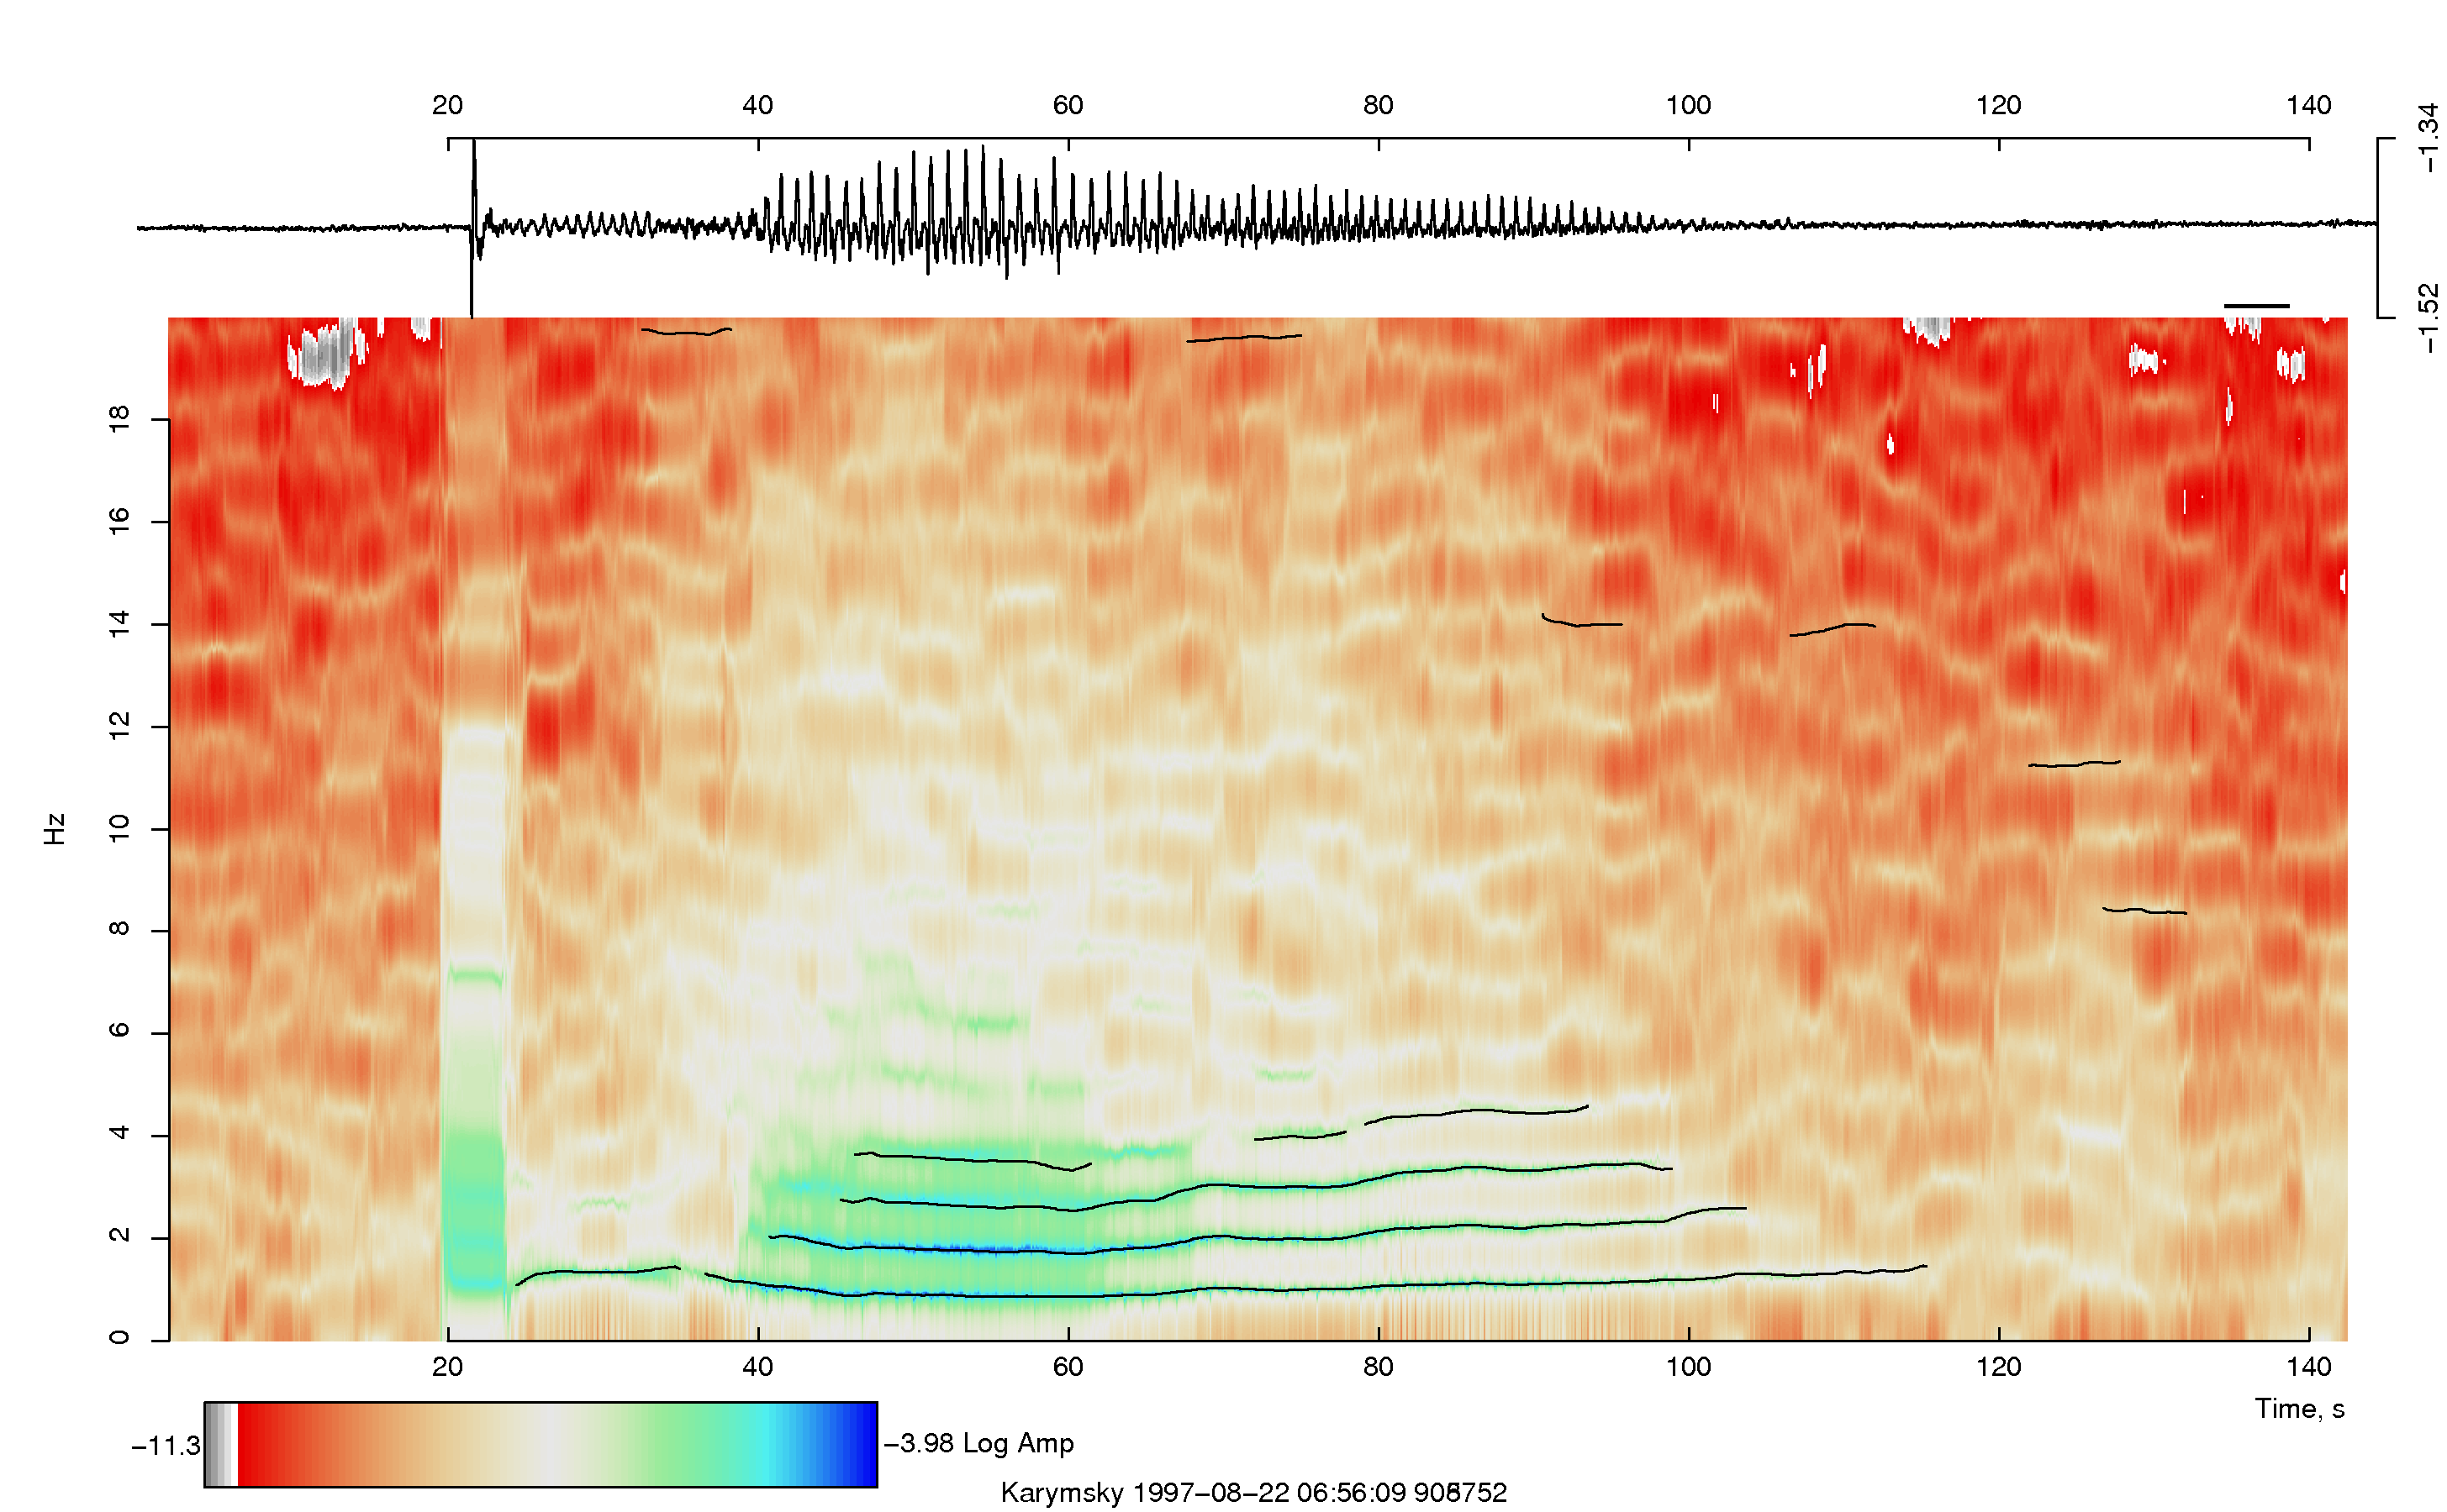
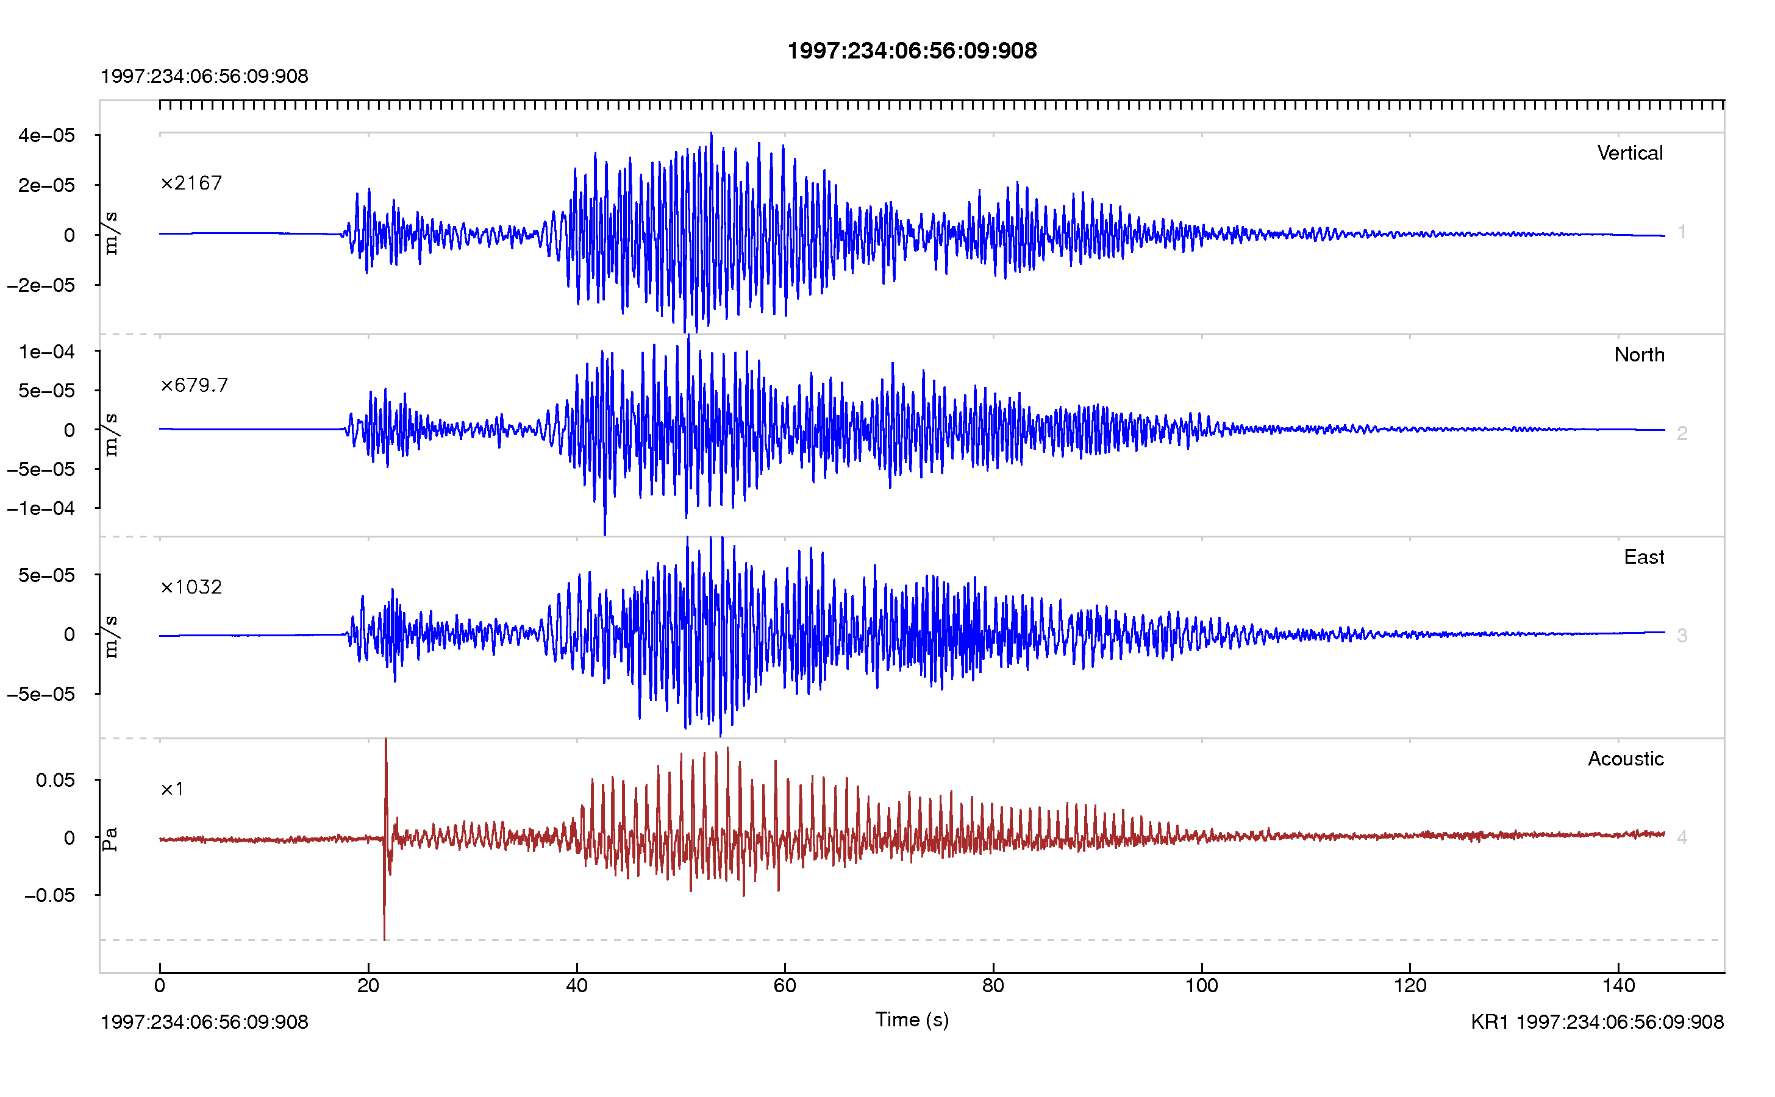
RSEIS
Seismic and Time Series Analysis
Reads seismic data SAC, SEGY, AH, ASCII
Spectrograms (MTM, AR)
Data-Base Extraction of seismic traces
Filtering
Deconvolution
Hodograms (Particle Motion)
Predict Arrival times
Moveout Displays
Event Location
Corner Frequency
Attenuation
Download from CRAN Website

Slide 3
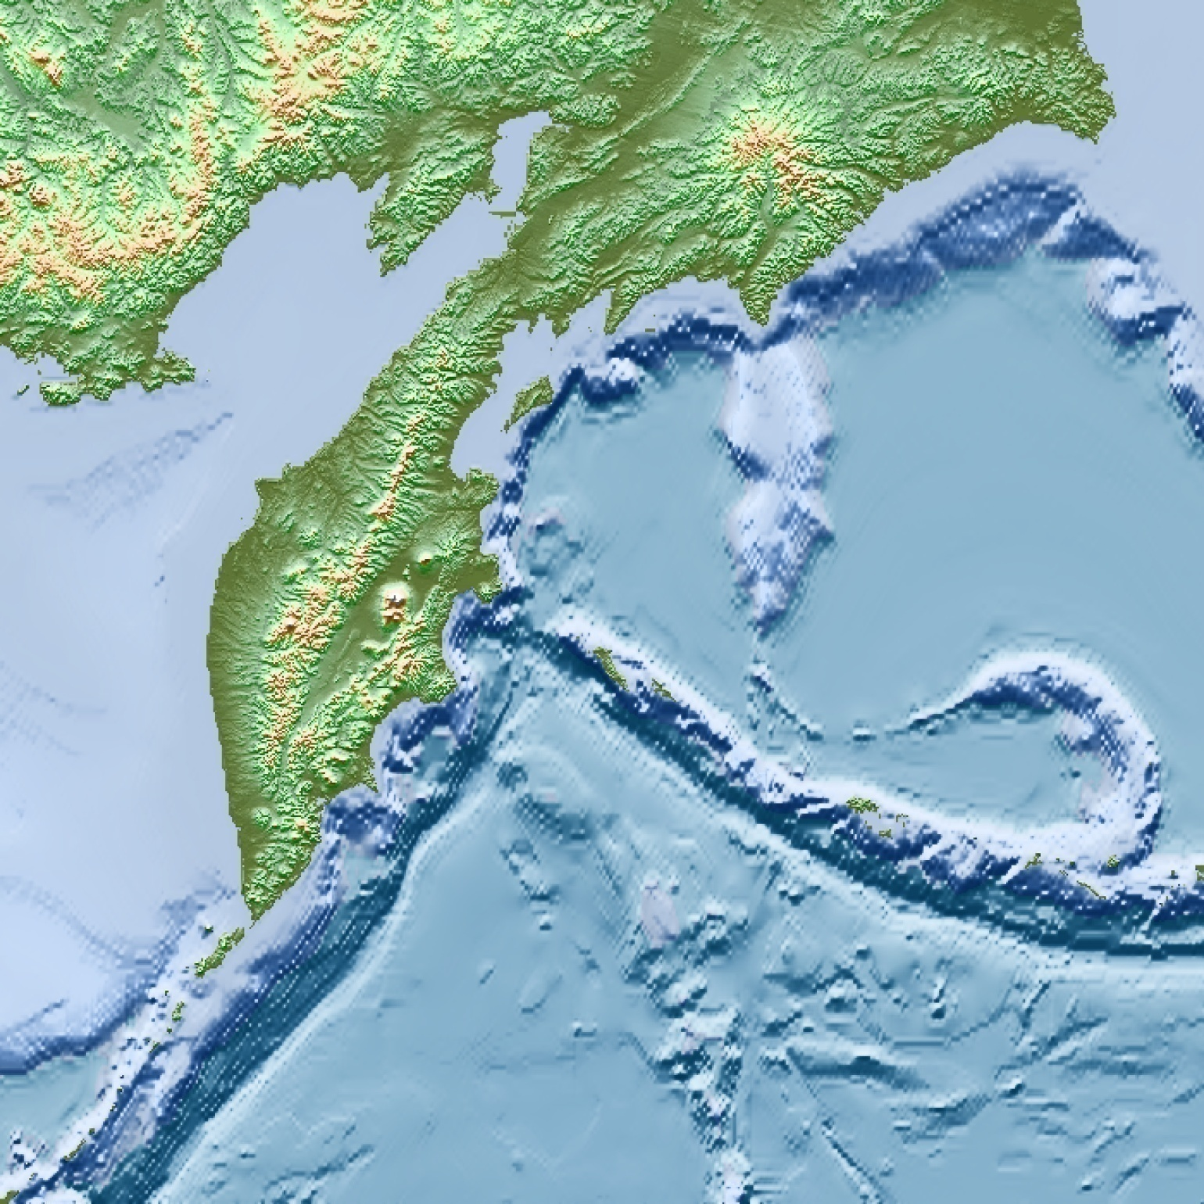
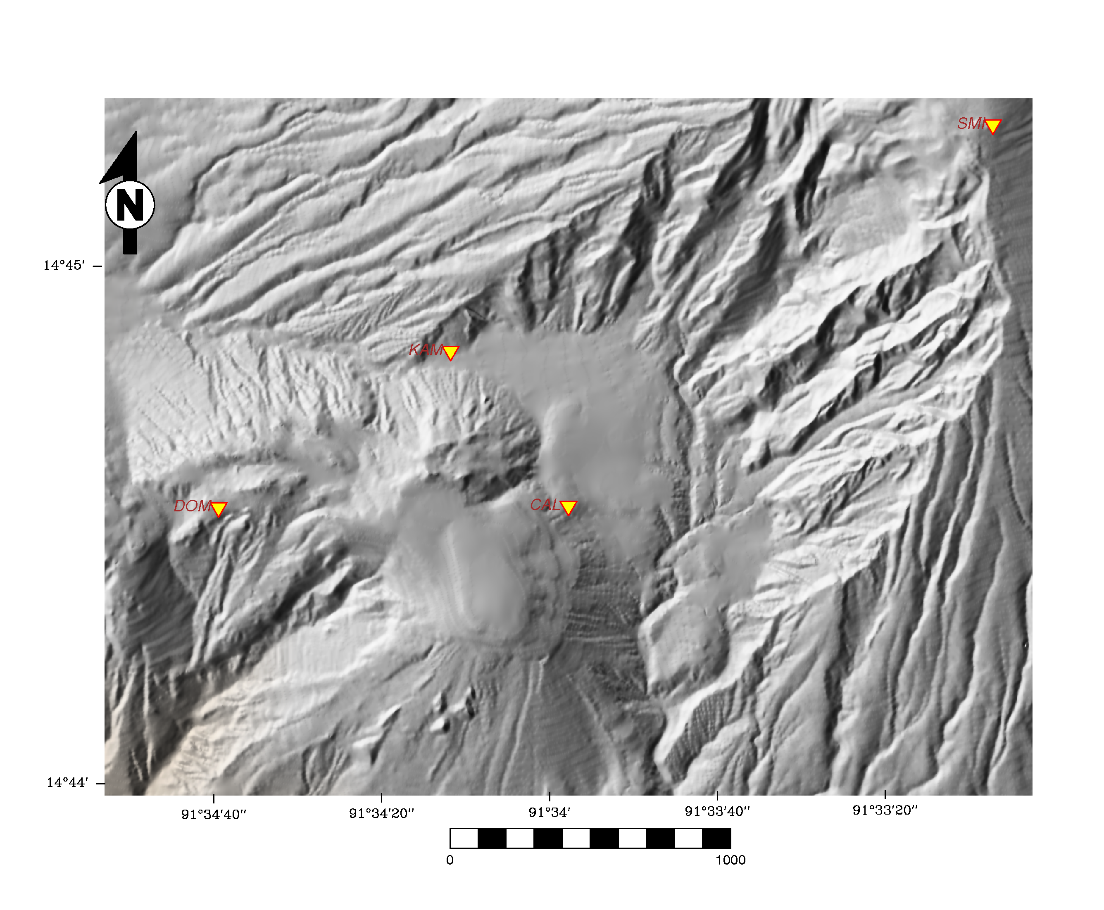
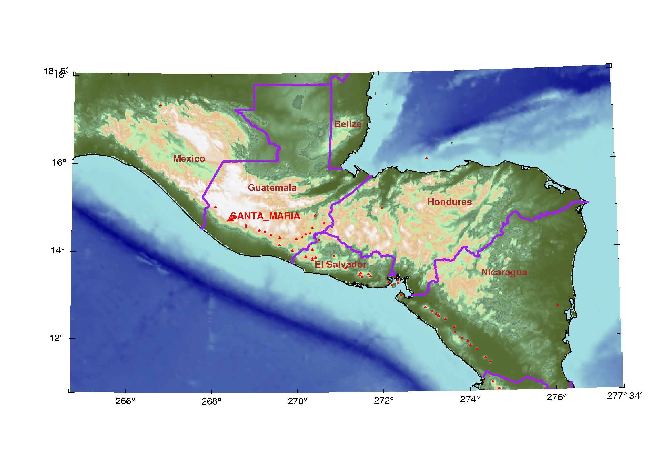
GEOmap
Topographic/Geologic Maps
Interactive Map
Geographic Projection
Geologic Symbols
Polygon/Area Analysis
Great Circles
Cross Sections
Download from CRAN Website

Slide 4
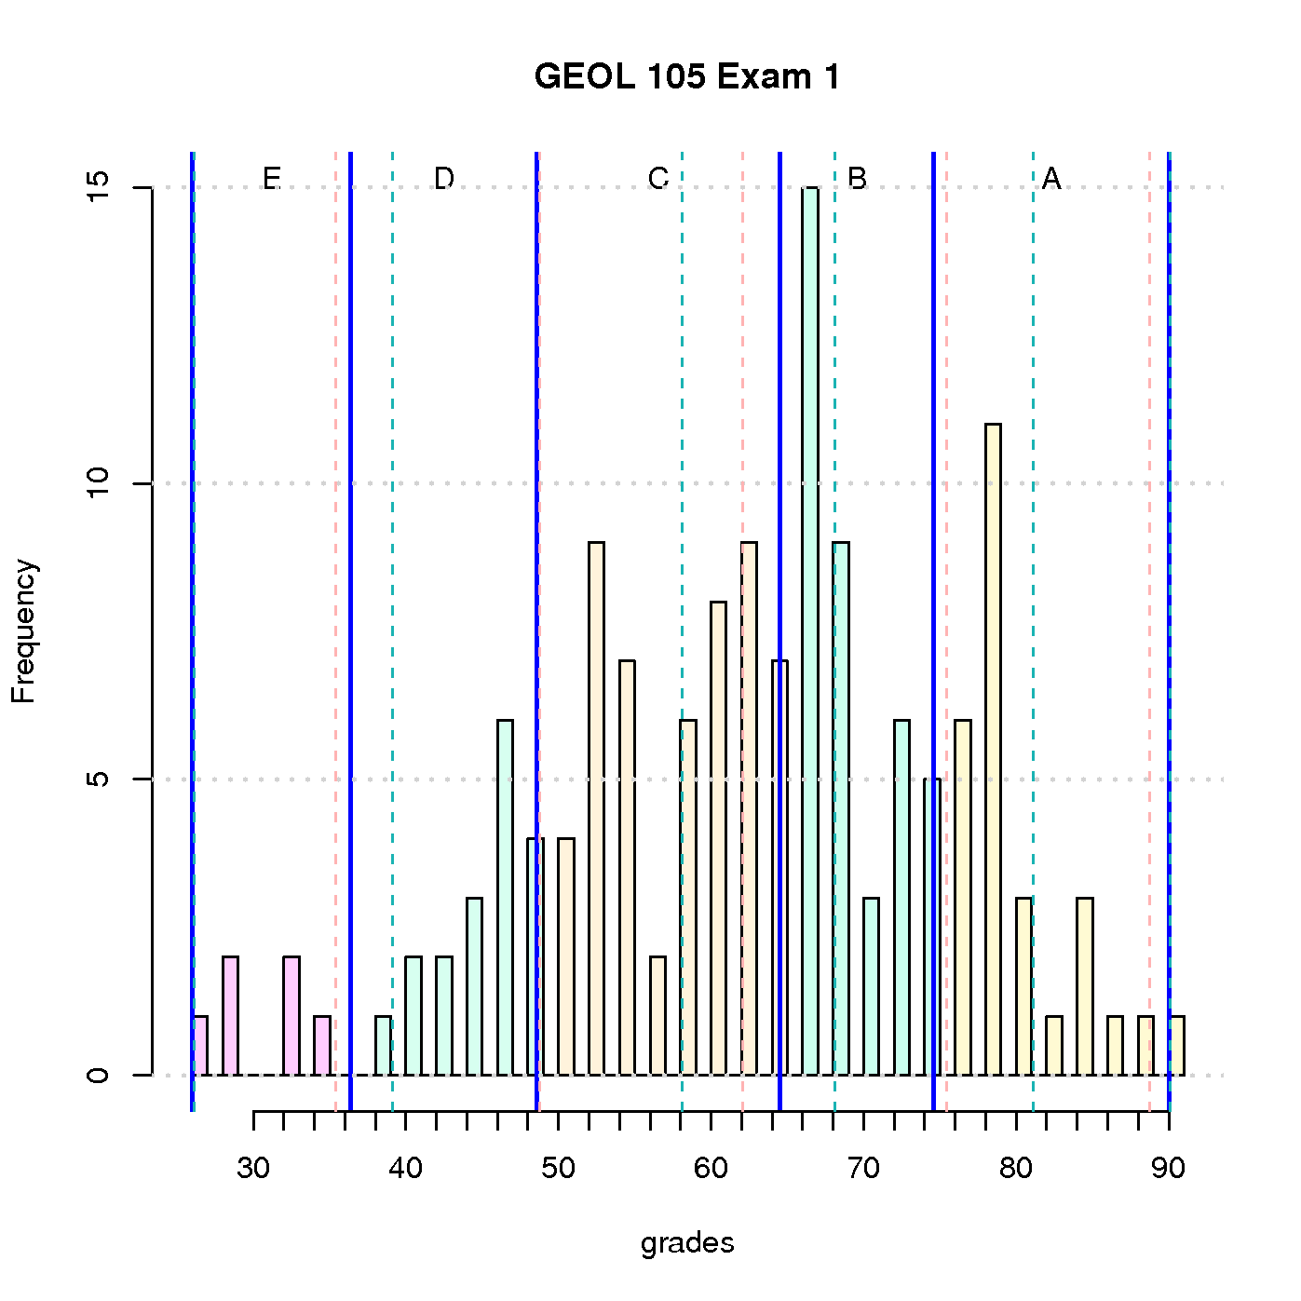
ProfessR
Set Grade Curve & assign Letter Grades
Exam Maker Create multiple choice exams
  randomly shuffled, different versions
Read ScanTron
  Make Scantron Key
Download from CRAN Website

Slide 5
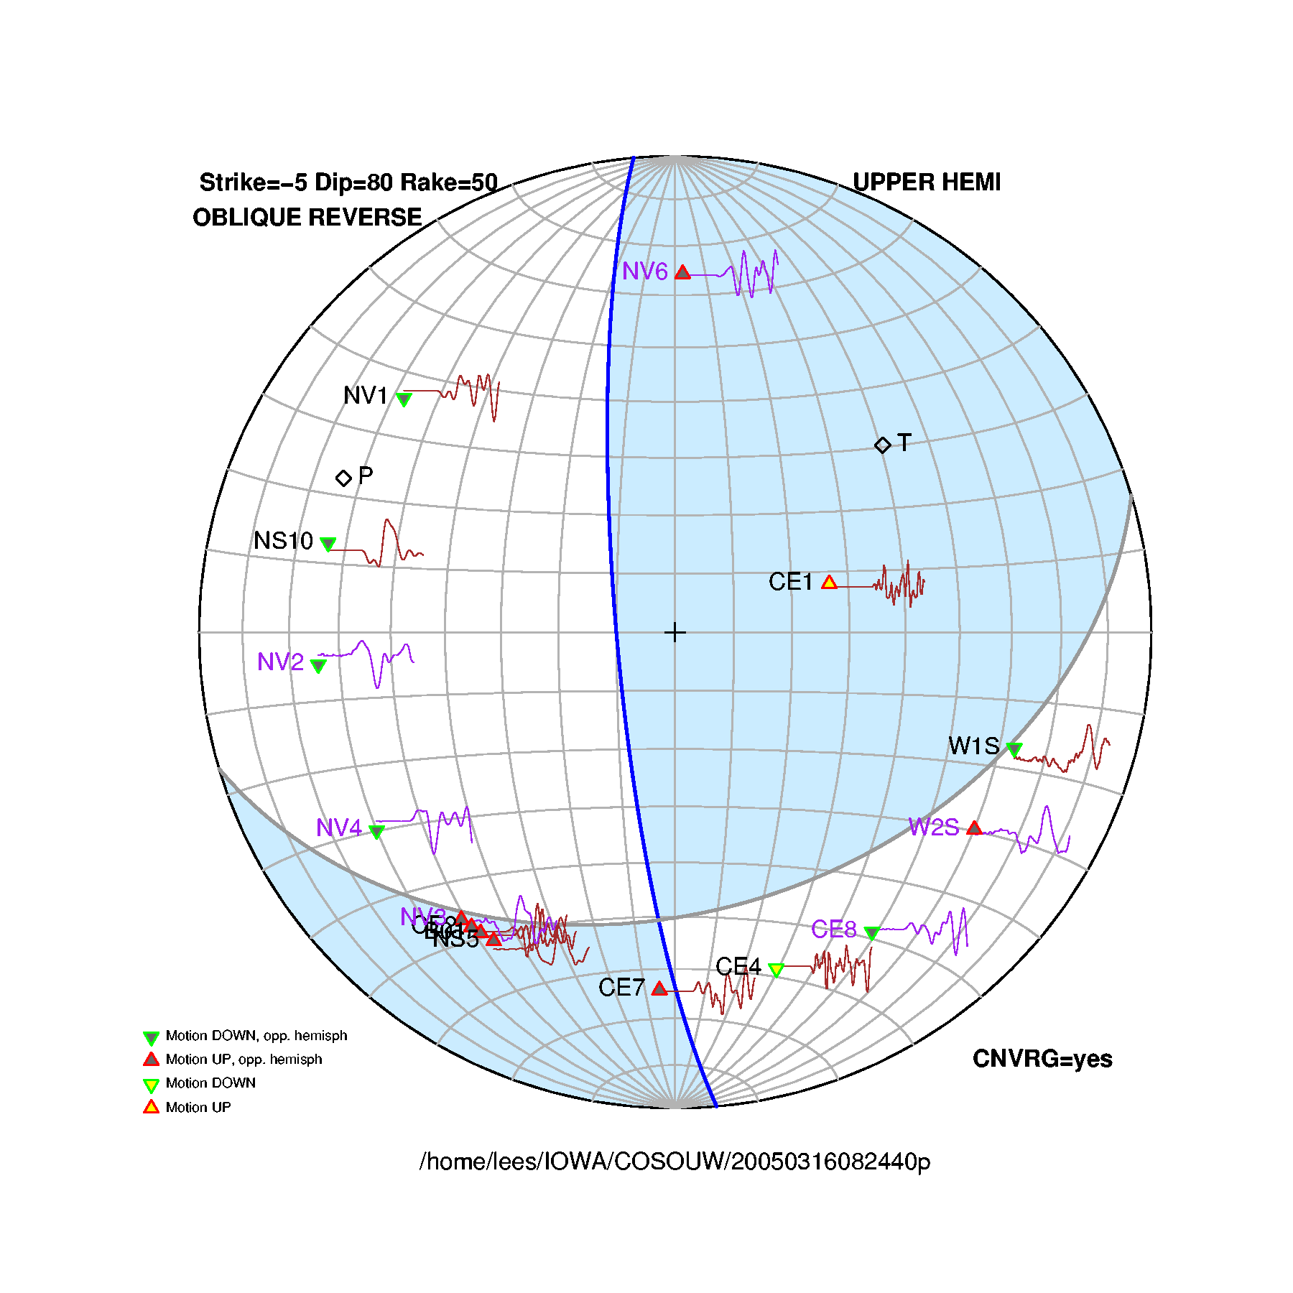
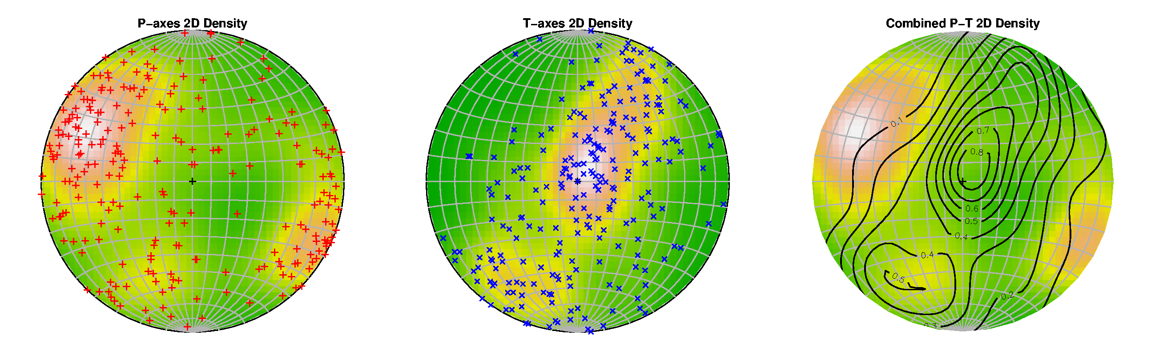
RFOC
Graphics for Spherical Distributions
Earthquake Focal Mechanisms
Graphics for statistics on a sphere
  geographical/geological maps
  earthquake focal mechanisms
  geological fault data
  radiation patterns
  crystalogaphy
  ternary plots
Download from CRAN Website

Slide 6
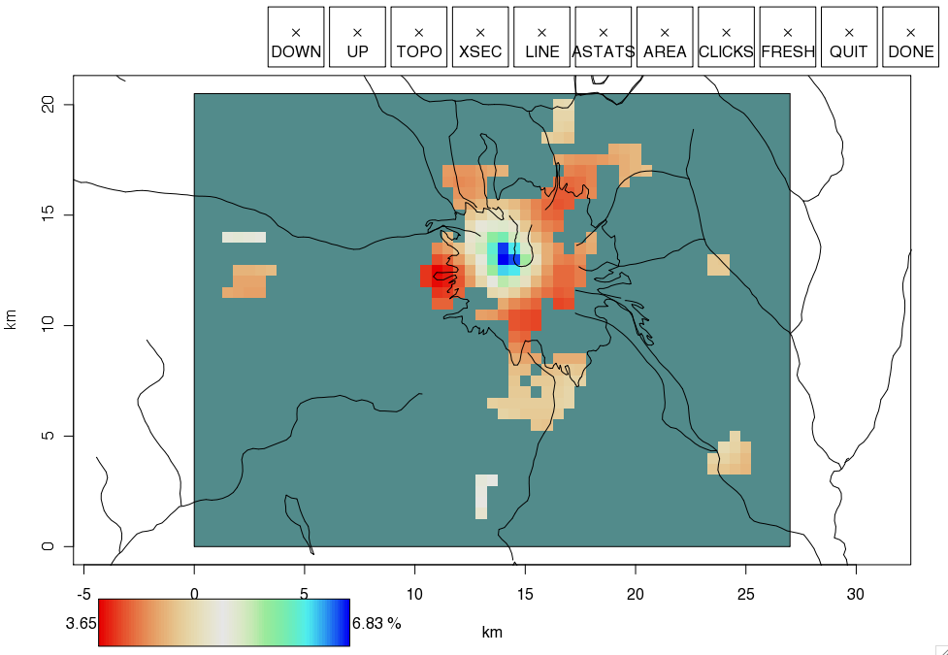
RTOMO
Visualization for seismic tomography
2D tomographic inversion
Download from CRAN Website

Slide 7
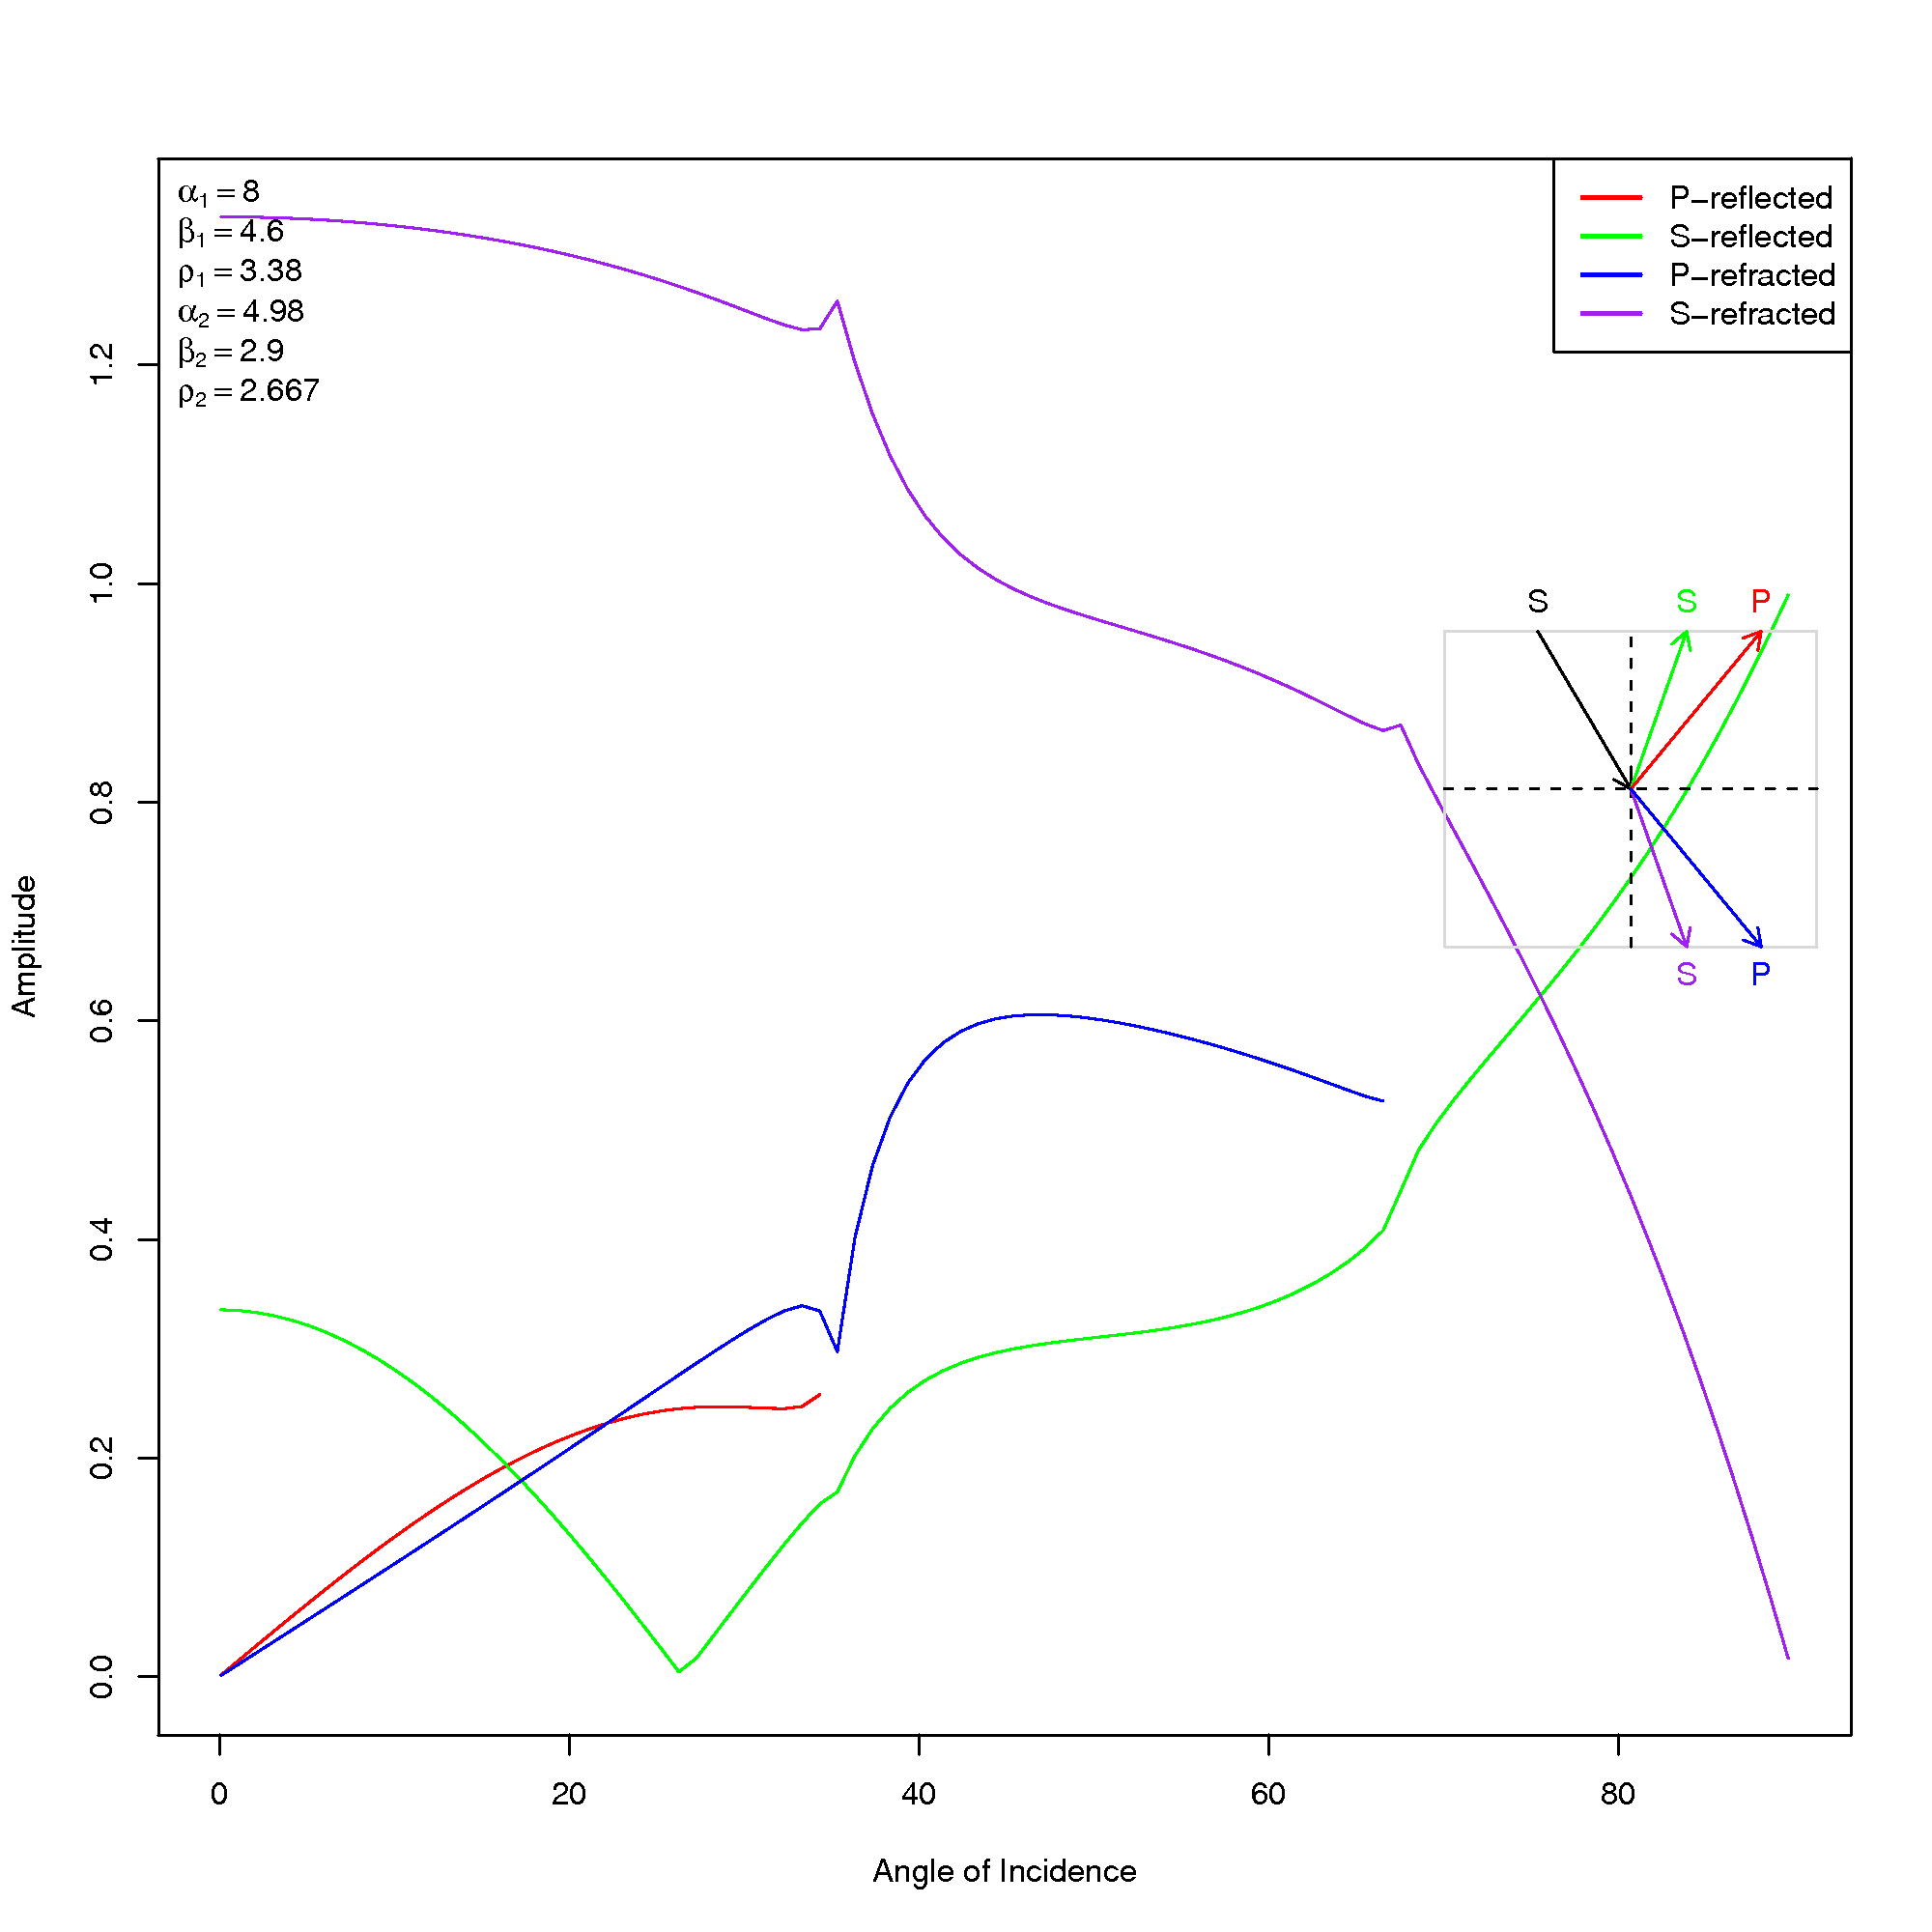
zoeppritz
Zoeppritz Equations
Calculate and plot scattering matrix coefficients for plane waves at interface
Download from CRAN Website

Slide 8
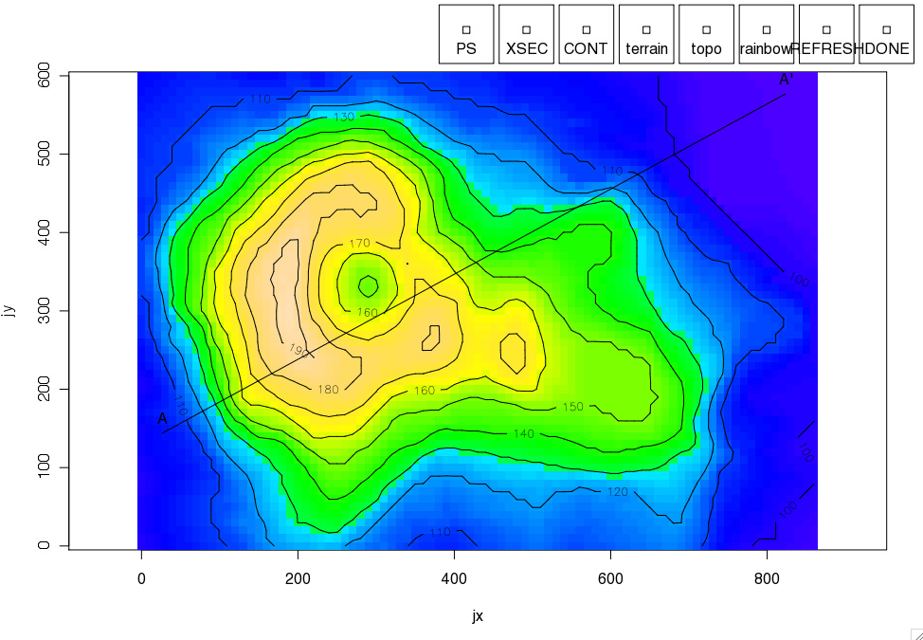
RPMG
Really Poor Man’s GUI
Define Buttons
Simple – uses only R commands
Download from CRAN Website

Slide 9
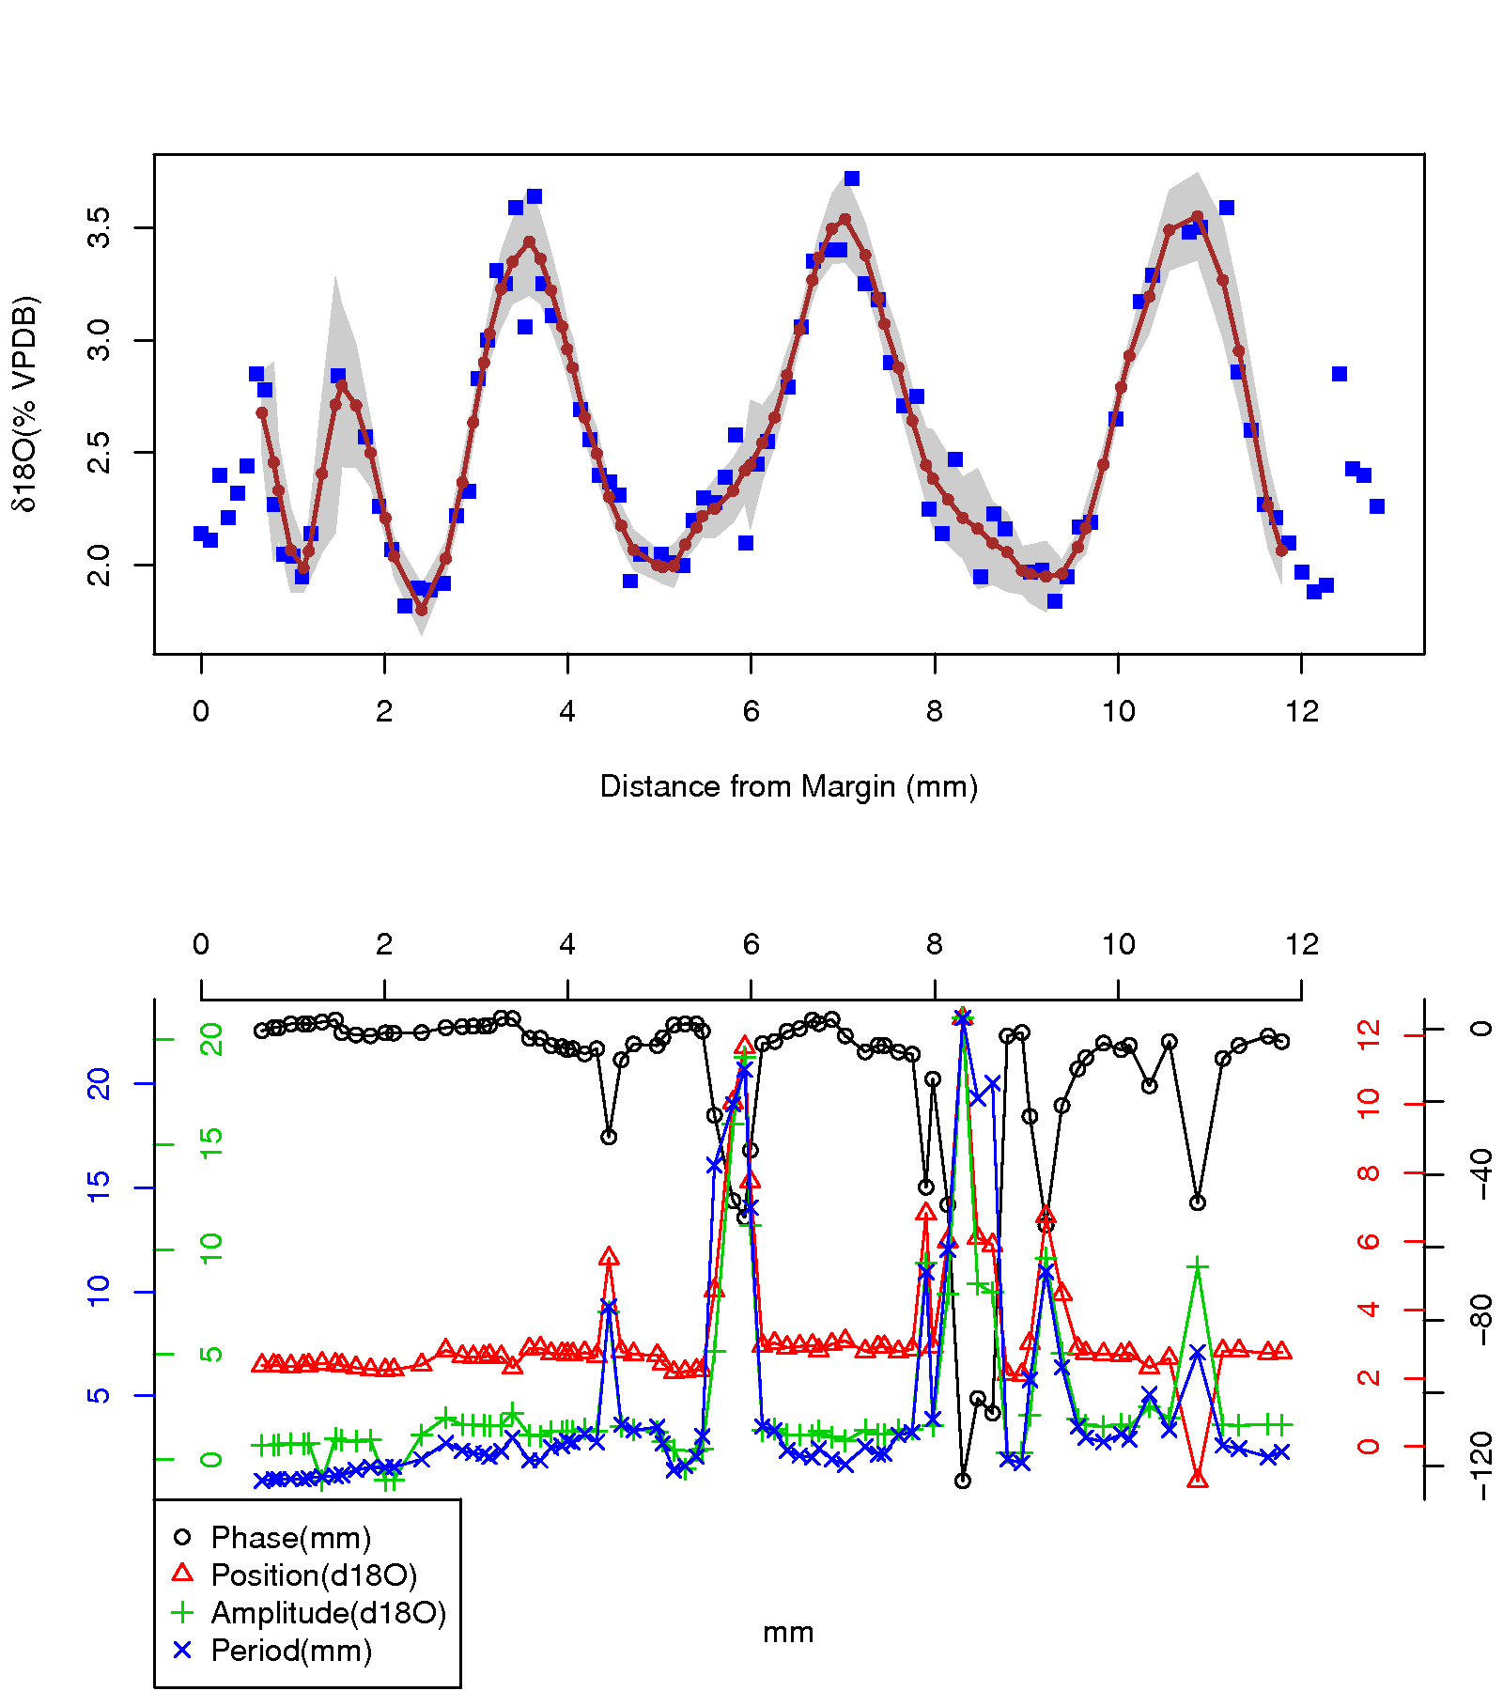
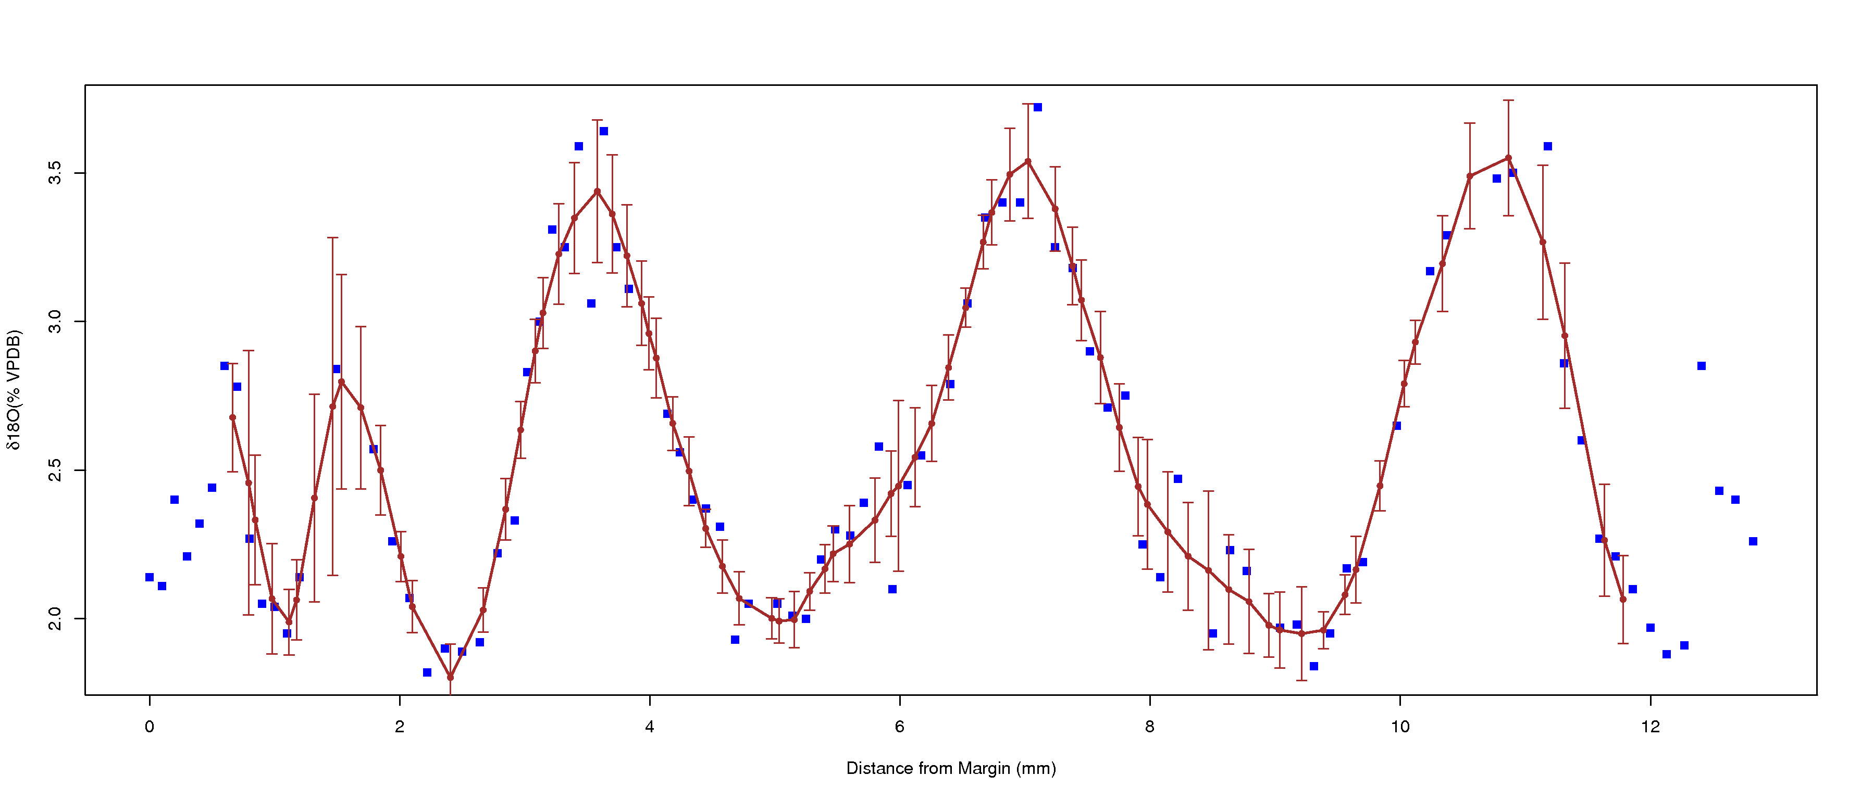
ClamR
Analysis of Climate Proxy Data
Sinusoidal Smoothing
JackKnife Error Estimation
Download from CRAN Website

